Slide 1
CLAS 220 Introduction to Classical Mythology
Homer, Odyssey 20-24

Slide 2
Quiz Question
Who, aside from Odysseus himself, comes closest to stringing the bow?
Antinoos
Telemachus
Eurymakhos
Eurykleia

Slide 3
Quiz Question
2. What does Eurykleia the nurse do when she sees the dead suitors?
Lament their deaths
Make a tasteless joke
Begin cleaning up the mess
Cry out in triumph

Slide 4
The Climax of the Poem
Timing is everything:
Penelope, Telemachus, Argos, Laertes: everyone is at the breaking-point
New Moon
Winter Solstice
(typically these recur together every 19 years or so)
Festival of Apollo
Nostos as return to life as well as return home
Transition to new generation
End of the Odyssey = end of the Age of Heroes

Slide 5
The Contest of the Bow
suspense builds as the test of the bow progresses
Telemachus almost succeeds
all the suitors fail
the disguised Odysseus asks if he can try

Slide 6
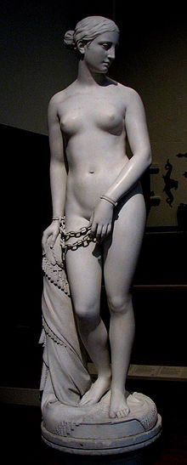
Odysseus the Insomniac
Now came a covey of women
Laughing as they slipped out, arm in arm,
As many a night before, to the suitor’s beds;
And anger took him like a wave to leap
Into their midst and kill them, every one –
Or should he let them all go hot to bed
One final night? His heart cried out within him
The way a brach with whelps between her legs
Would howl and bristle at a stranger – so
The hackles of his heart rose at that laughter.
Knocking his breast he muttered to himself.
“Down, be steady. You’ve seen worse, that time
The Kyklops like a rockslide ate your men
While you looked on. Nobody, only guile,
Got you out of that cave alive.”
20.8-21

Slide 7
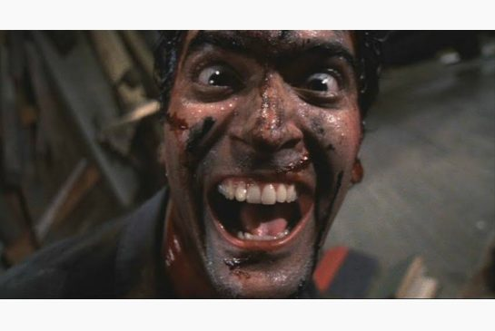
The Suitors Lose Control
Pallas Athena touched off in the suitors
A fit of laughter, uncontrollable.
She drove them into nightmare, till they wheezed
And neighed as though with jaws no longer theirs,
While blood defiled their meat, and blurring tears
Flooded their eyes, heart-sore with woe to come.
20. 387-392

Slide 8
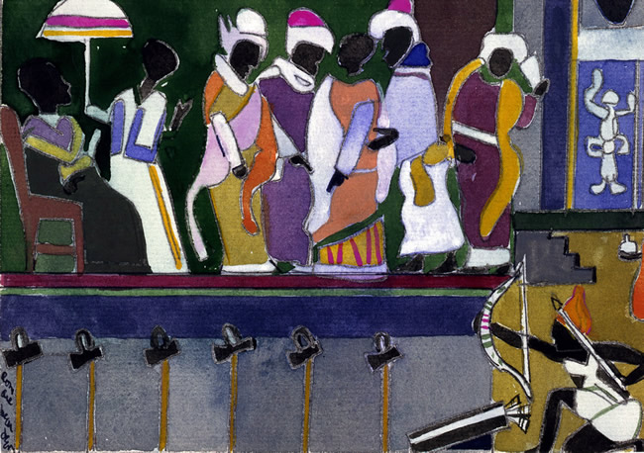
Telemakhos almost strings the bow
He took his stand then
On the broad door sill to attempt the bow.
Three times he put his back into it and sprang it,
Three times he had to slack off. Still he meant
To string the bow and pull for the needle shot.
A fourth try and he had it all but strung –
When a stiffening in Odysseus made him check….
21. 140-146

Slide 9
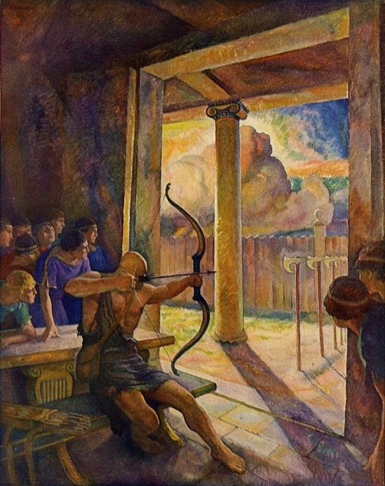
Odysseus asks to try
Then spoke Odysseus, all craft and gall:
“My lords, contenders for the queen, permit me:
A passion in me moves to speak out.
I put it to Eurymakhos above all
And to that brilliant prince, Antinoos. Just now
How wise his counsel as, to leave the trial
And turn your thoughts to the immortal gods! Apollo
Will give power tomorrow to whom he wills.
But let me try my hand at the smooth bow!...”
21.310-18

Slide 10
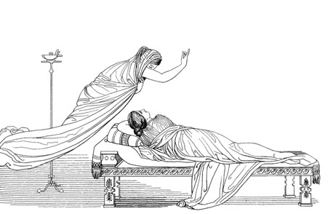
Telemachus and Penelope
“Mother, as to the bow and who may handle it
Or not handle it, no man here
Has more authority than I do – not one lord
Of our own stony Ithaka nor the islands lying
East toward Elis: no one stops me if I choose
To give these weapons outright to my guest.
Return to your own hall. Tend your spindle.
Tend your loom. Direct your maids at work.
This question of the bow will be for men to settle,
Most of all for me. I am master here.”
She gazed in wonder, turned, and so withdrew,
Her son’s clearheaded bravery in her heart.
But when she had mounted to her rooms again
With all her women, then she fell to weeping
For Odysseus, her husband. Grey-eyed Athena
Presently cast a sweet sleep over her eyes.

Slide 11
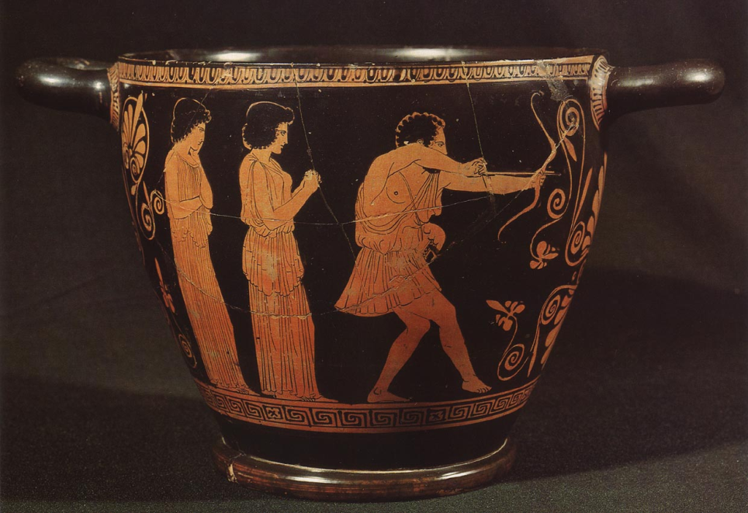
The old man strings the bow
But the man skilled in all ways of contending,
Satisfied by the great bow’s look and heft,
Like a musician, like a harper, when
With quiet hand upon his instrument
He draws between his thumb and forefinger
A sweet new string upon a peg: so effortlessly
Odysseus in one motion strung the bow.
Then slid his right hand down the cord and plucked it,
So the taut gut vibrating hummed and sang
A swallow’s note….
21.460-70

Slide 12
Quiz Question
3. Who is the worst of the suitors, and the first to die?
Antinoos
Eumaios
Melanthion
Eurymakhos

Slide 13
Revenge
Odysseus' timing is perfect
could not have waited a day longer (wife, son, dog)
revenge is also total, and brutal, and unseemly
cannot be the end of things

Slide 14
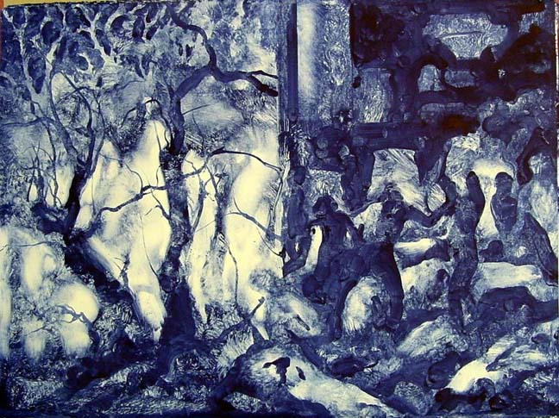
The Killing Begins
“So much for that. Your clean-cut game is over.
Now watch me hit a target that no man has hit before,
If I can make this shot. Help me, Apollo.”
He drew to his fist the cruel head of an arrow for Antinoos
Just as the young man leaned to lift his beautiful drinking cup,
Embossed, two-handled, golden; the cup was in his fingers:
The wine was even at his lips: and did he dream of death?
How could he? In that revelry amid his throng of friends
Who would imagine a single foe – though a strong foe indeed –
Could dare to bring death’s pain on him and darkness on his eyes?
Odysseus’ arrow hit him under the chin
And punched up to the feathers through his throat.
Backward and down he went, letting the winecup fall
From his shocked hand. Like pipes his nostrils jetted
Crimson runnels, a river of mortal red,
And one last kick upset his table
Knocking the bread and meat to soak in dusty blood.
22.4-21

Slide 15
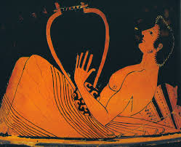
The bard is safe (of course…).
One more who had avoided furious death
Was the son of Terpis, Phemios, the minstrel,
Singer by compulsion to the suitors.
He stood now with his harp, holy and clear,
In the wall’s recess, under the window, wondering
If he should flee that way to the courtyard altar,
Sanctuary of Zeus, the enclosure God….
No, he thought;
The more direct way would be best – to go
Humbly to his lord. But first to save
His murmuring instrument he laid it down
Carefully between the winebowl and a chair…
22.271-83

Slide 16
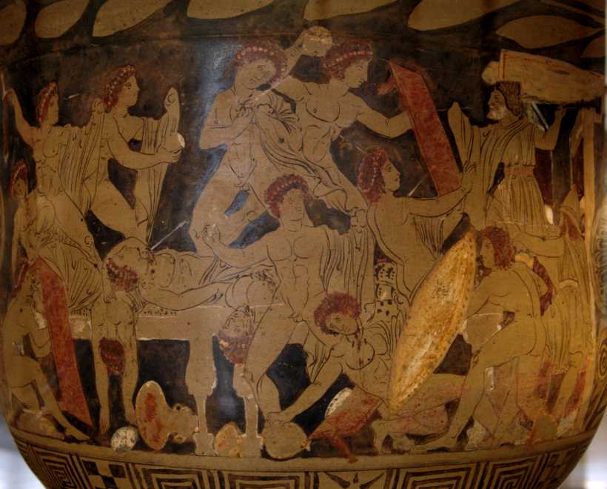
Eurykleia Triumphs
His call brought no reply, only the doors
Were opened and she came. Telemakhos
Led her forward. In the shadowy hall
Full of dead men she found his father
Spattered and caked with blood like a mountain lion
With hot blood glistening over his whole chest,
Smeared on his jaws, baleful and terrifying –
Even so encrimsoned was Odysseus
Up to his thighs and armpits. As she gazed
From all the corpses to the bloody man
She raised her head to cry over his triumph,
But felt his grip upon her, checking her.
22.446-59

Slide 17
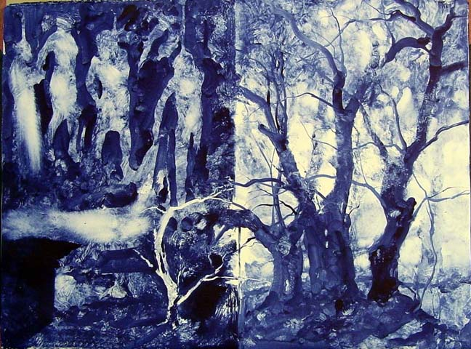
The serving-women killed
He tied one end of a hawser to a pillar
and passed the other about the roundhouse top,
Taking the slack up, so that no one’s toes
Could touch the ground. They would be hung like doves
Or larks in springes triggered in a thicket,
Where the birds think to rest – a cruel nesting.
So now in turn each woman thrust her head
Into a noose and swung, yanked high in air,
To perish there most piteously.
Their feet danced for a little, but not long.
22.517-526
17. Lynching of the House Maidens.
Spasm in the pelvis, involuntarily jerking legs: they
have known this dance before. It wasn't called
justice, then. Pleasure takes us by storm. One has to
have a knack for abandoning oneself, that too is an
art. The human body would break most olive boughs,
there is such weight in us.
Rosanna Warren

Slide 18
Reconciliation
need for full recognition and reconciliation between Odysseus and Penelope
need for reconciliation with father
need for an end to vengeance
also an end to the heroic era

Slide 19
Quiz Question
4. What piece of furniture does Penelope want moved?
The sofa
The wardrobe
The dining table
The bed

Slide 20
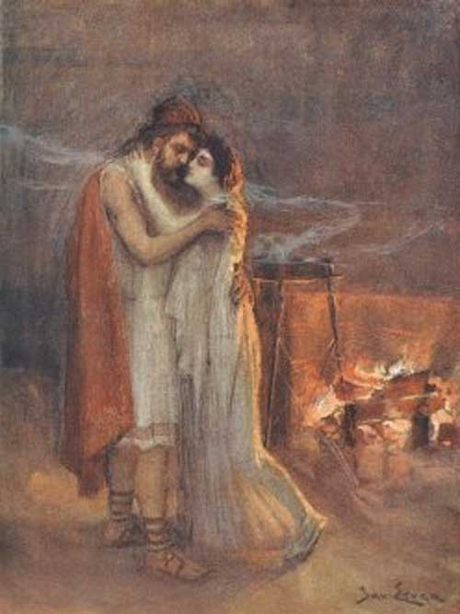
Penelope Sees Odysseus
And she, for a long time, sat deathly still
In wonderment – for sometimes as she gazed
She found him – yes, clearly – like her husband,
But sometimes blood and rags were all she saw.
23. 104-107

Slide 21
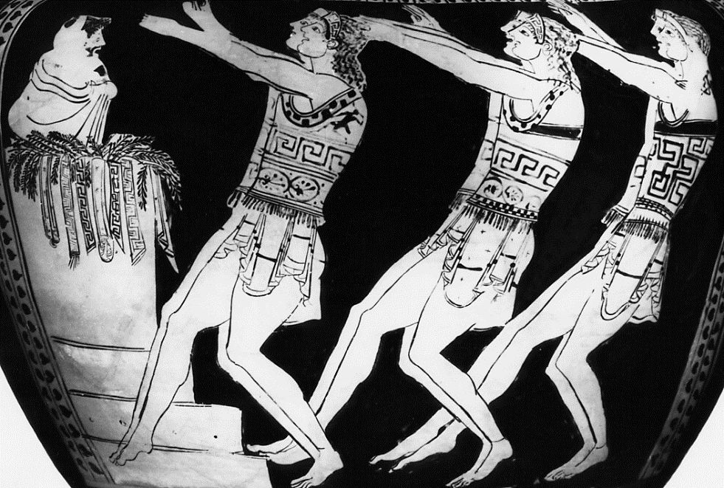
Odysseus’ Trick
Here is our best maneuver, as I see it:
Bathe, you three, and put fresh clothing on,
Order the women to adorn themselves,
And let our admirable harper choose a tune
For dancing, some lighthearted air, and strum it.
Anyone going by, or any neighbor,
Will think it is a wedding feast he hears.
23.149-55

Slide 22
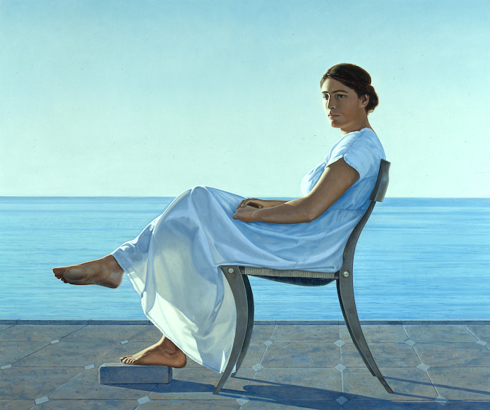
Penelope’s Test
“Make up his bed for him, Eurykleia,
Place it outside the bedchamber my lord
Built with his own hands. Pile the big bed
With fleeces, rugs, and sheets of purest linen.”
With this she tried him to the breaking point,
And he turned on her in a flash raging:
“Woman, by heaven you’ve stung me now!
Who dared to move my bed?...
23.202-10

Slide 23
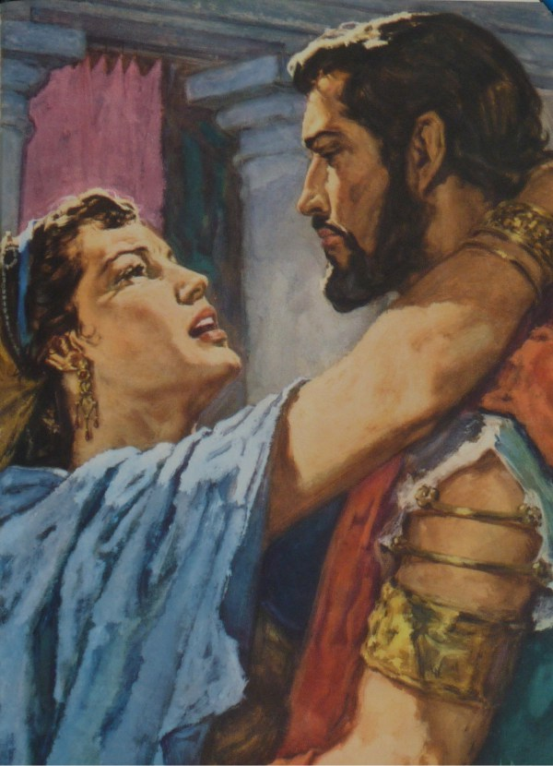
Odysseus and Penelope Share Stories
The royal pair mingled in love again
And afterward lay revelling in stories:
Hers of the siege her beauty stood at home
From arrogant suitors, crowding on her sight,
And how they fed their courtship on his cattle,
Oxen and fat sheep, and drank up rivers
Of wine out of the vats. Odysseus told
Of what hard blows he had dealt out to others
And of what blows he had taken – all that story,
She could not close her eyes till all was told…
23.337-46

Slide 24
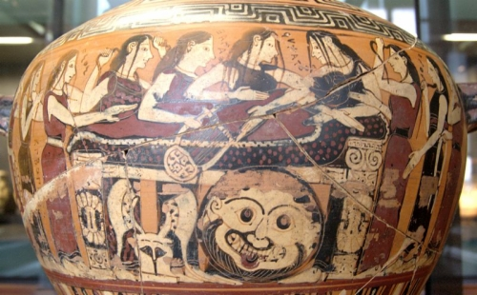
The Funeral of Akhilleus
Like a forest fire the flame roared on, and burned
Your flesh away. Next day at dawn, Akhilleus,
We picked your pale bones from the char to keep
In wine and oil. A golden amphora
Your mother gave for this – Hephaistos’ work,
A gift from Dionysos. In that vase,
Akhilleus, hero, lie your pale bones mixed
With mild Patroklos’ bones, who died before you,
And nearby lie the bones of Antilokhos,
The one you cared for most of all companions
After Patroklos. We of the Old Army,
We who were spearmen, heaped a tomb for these
Upon a foreland over Helle’s waters,
To be a mark against the sky for voyagers
In this generation and those to come…
24.81-95

Slide 25
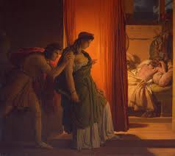
Agamemnon compares wives
But Agamemnon’s
Tall shade when he heard this cried aloud:
“O fortunate Odysseus, master mariner
And soldier, blessed son of old Laertes!
The girl you brought home made a valiant wife!
True to her husband’s honor and her own,
Penelope, Ikarios’ faithful daughter!
The very gods themselves will sing her story
For men on earth – mistress of her own heart,
Penelope!
Tyndareus’ daughter waited, too – how differently!
Klytaimnestra, the adulteress,
Waited to stab her lord and king. That song
Will be forever hateful. A bad name
She gave to womankind, even the best.”
24.213-28

Slide 26
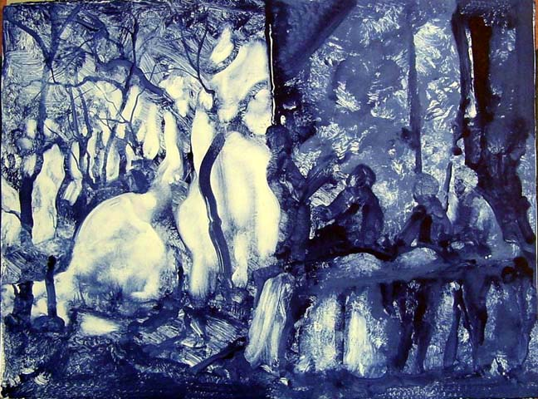
One more lie
Again Odysseus had a fable ready.
“Yes,” he said, “I can tell you all those things.
I come from Rover’s Passage where my home is,
And I’m King Allwoes’ only son. My name
Is Quarrelman. Heaven’s power in the westwind
Drove me this way from Sikania,
Off my course. My ship lies in a barren
Cove beyond the town there. As for Odysseus,
Now is the fifth year since he put to sea
And left my homeland – bound for death, you say ....
24.332-42

Slide 27
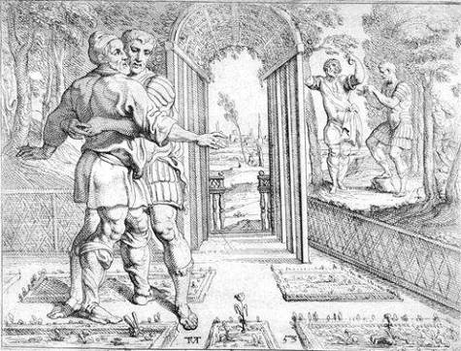
One more test
Again – more proof – let’s say the trees you gave me
On this revetted plot of orchard once.
I was a small boy at your heels, wheedling
Amid the young trees, while you named each one.
You gave me thirteen pear, ten apple trees,
And forty fig trees. Fifty rows of vines
Were promised too, each one to bear in turn.
Bunches of every hue would hang there ripening,
Weighed down by the god of summer days.”
The old man’s knees failed him, his heart grew faint,
Recalling all that Odysseus calmly told….
24.371-81

Slide 28
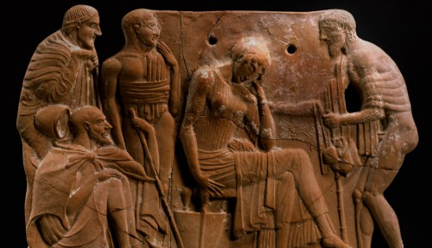
Laertes’ Proudest Moment
“Ah, what a day for me, dear gods!
To see my son and grandson vie in courage!”
24. 571-572

Slide 29
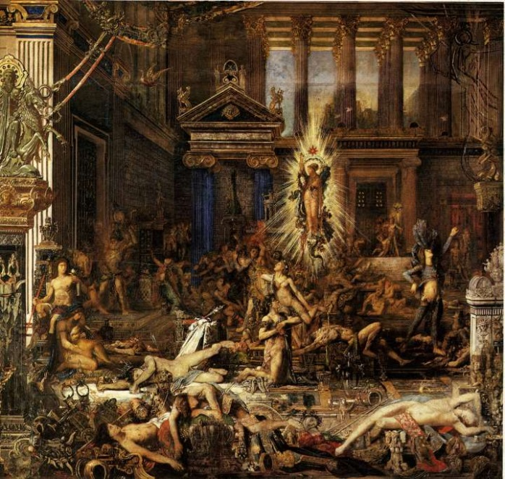
Athena Stops It All
“Son of Laertes and the gods of old,
Odysseus, master of land ways and sea ways,
Command yourself. Call off this battle now,
Or Zeus who views the wide world may be angry.”
24.606-610

Slide 30
… or is it?
THE END

Slide 31
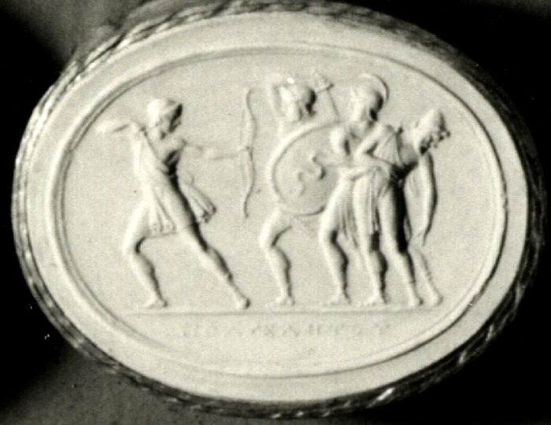
Telegony
Odysseus performs the sacrifice described by Teiresias,
he visits the mainland areas of Elis and Thesprotia
and is accidentally killed by his son with Kirke, Telegonos!
Telegonos takes Telemakhos and Penelope with him to Kirke’s island,
Kirke marries Telemakhos, and Telegonos marries Penelope.

Slide 32
Quiz Question
5. What is the name of Odysseus’ father?
Telemachus
Telegonus
Laertes
Claudius

